Slide 1

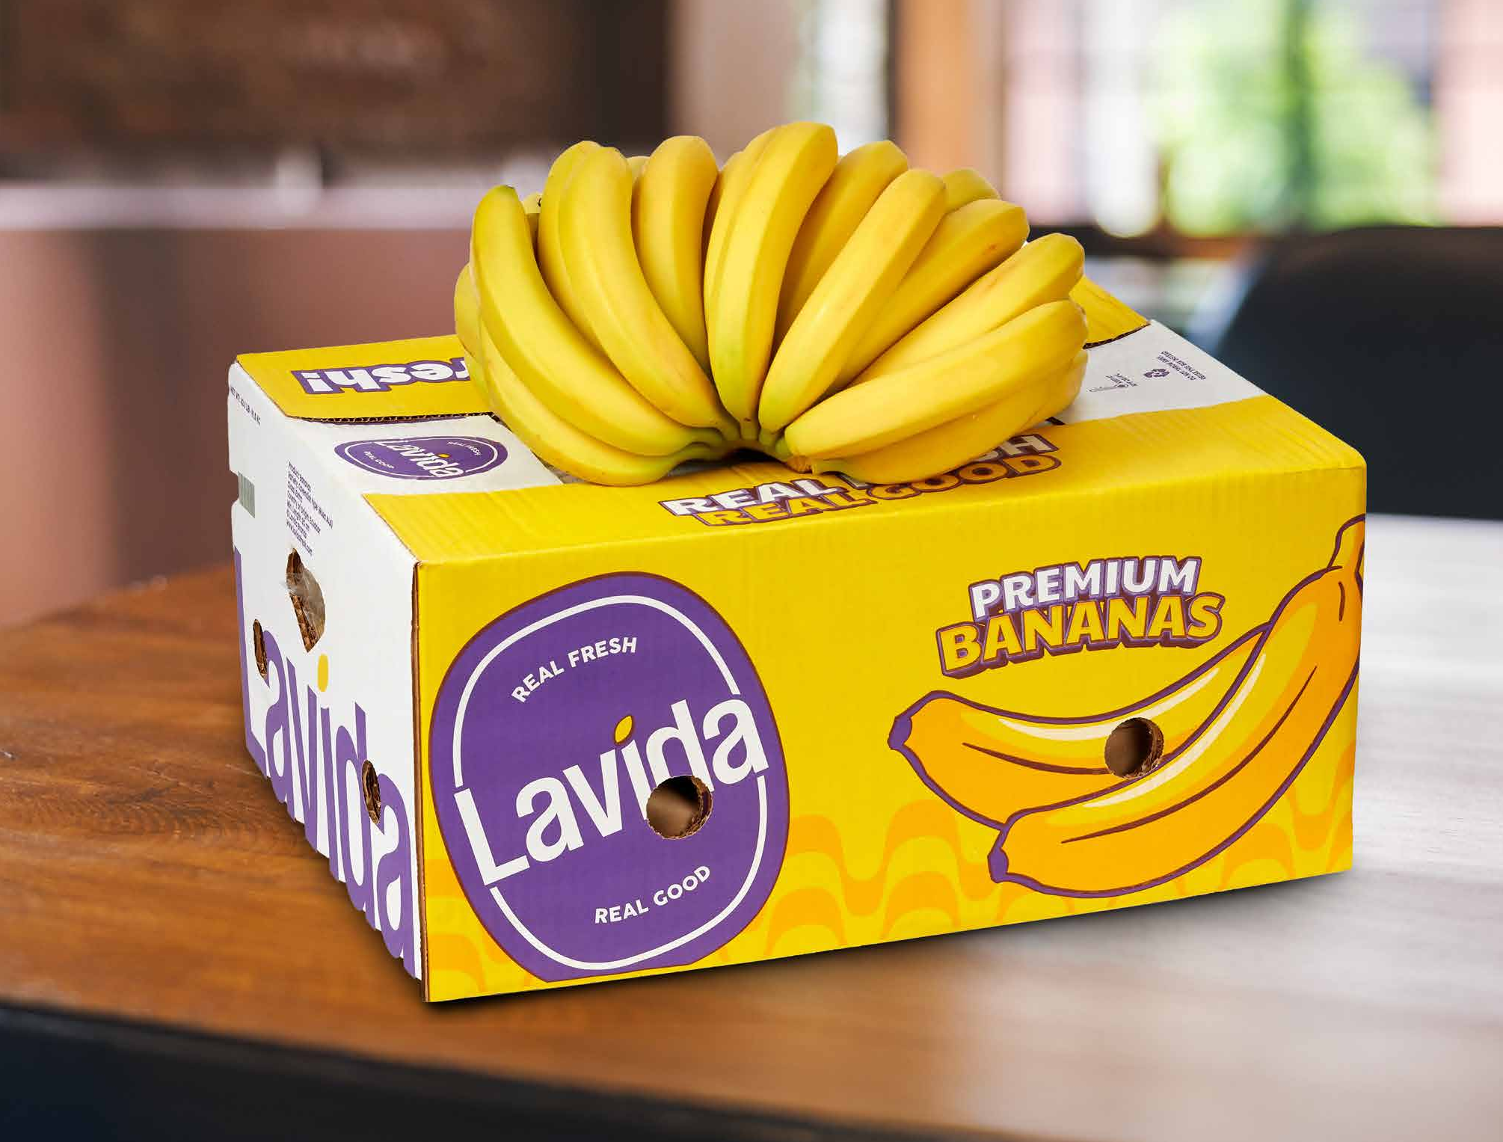
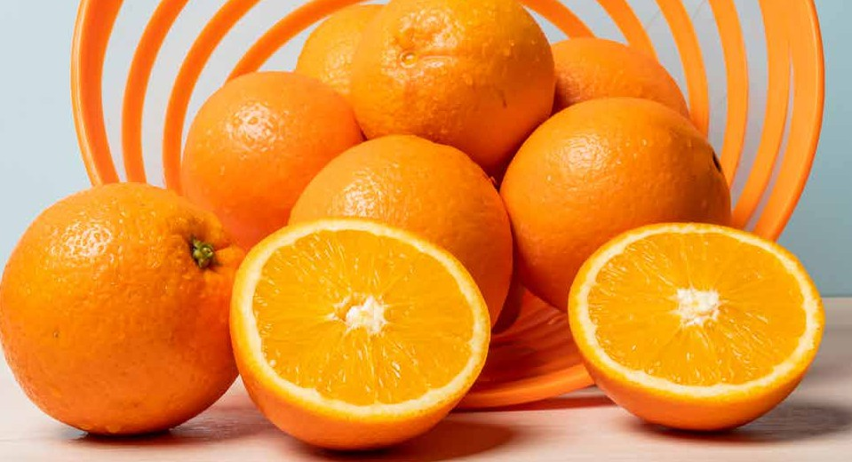

FRESH PRODUCE
AMENITY BASKET
BANANA
VARIETY/CLASS
Cavendish
ORIGIN
Ecuador/ Indonesia/ Vietnam
ORANGE
VARIETY/CLASS
APPLE
VARIETY/CLASS Red/ Green/ Royal Gala
Valencia/ Navel
ORIGIN
South Africa/ Egypt/ Australia
ORIGIN
USA/ South Africa/ New Zealand

Slide 2
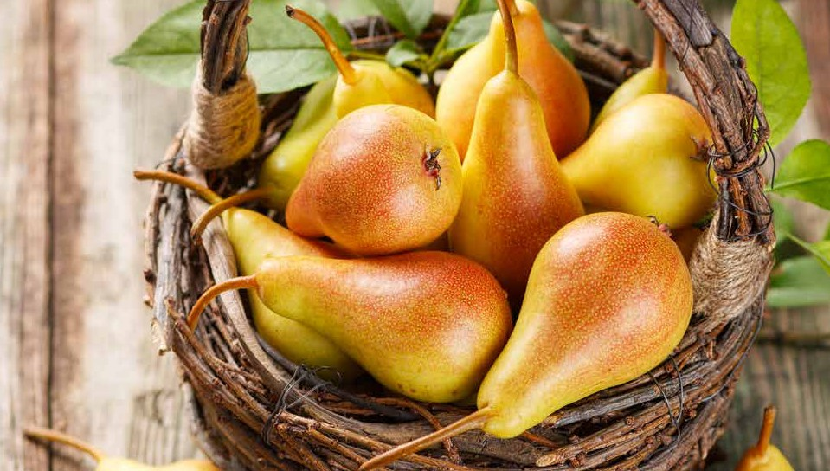
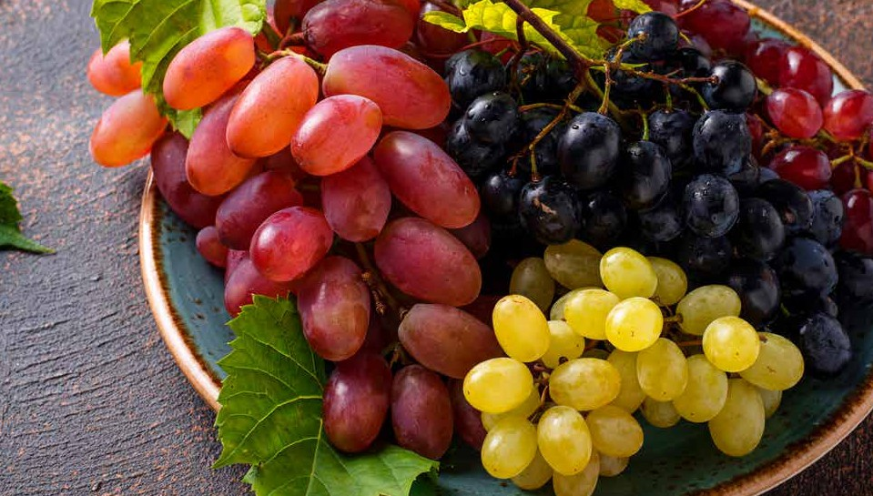
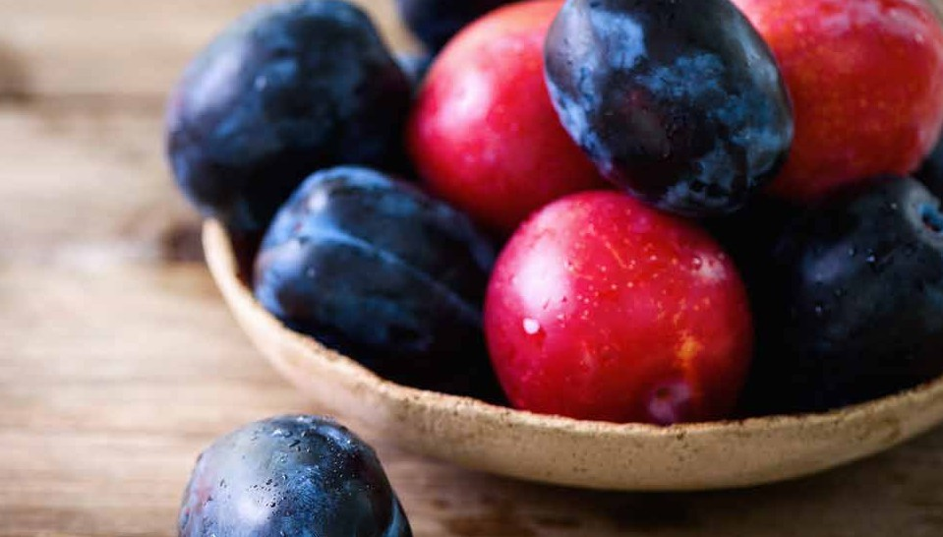
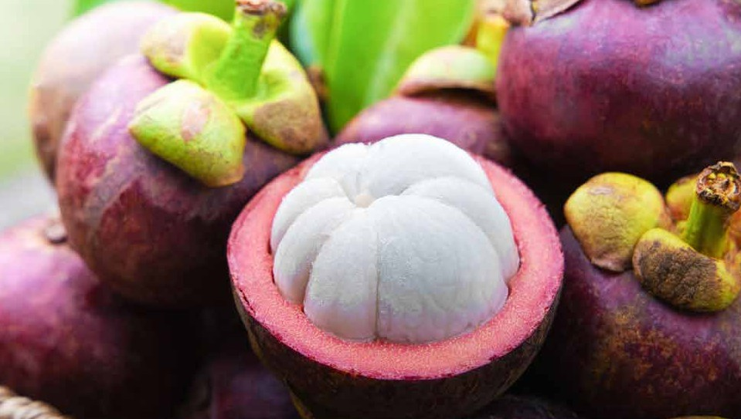
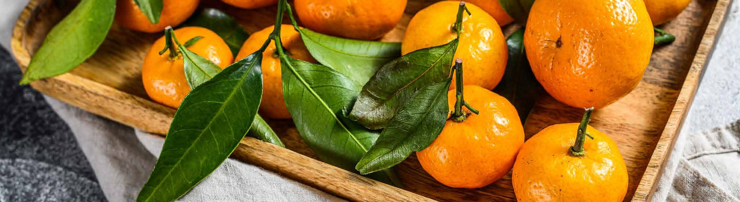
FRESH PRODUCE
PEARS
VARIETY/CLASS
GRAPES
VARIETY/CLASS White/ Green/ Red (Seed,
Seedless)
USA/ India/ Egypt/ Lebanon, South Africa
D'anjo/ Rosemary/ Nashi
ORIGIN
USA/South Africa/Chile/ Spain/China/Belgium/ Argentina/Turkey
ORIGIN
PLUMS
VARIETY/CLASS
MANGOSTEEN
ORIGIN Thailand/ Vietnam
Red/ Black
ORIGIN
South Africa/ Spain
MANDARINE
VARIETY/CLASS Clementine/ Nadarcot/ Tango
ORIGIN South Africa/ Egypt/ Australia

Slide 3
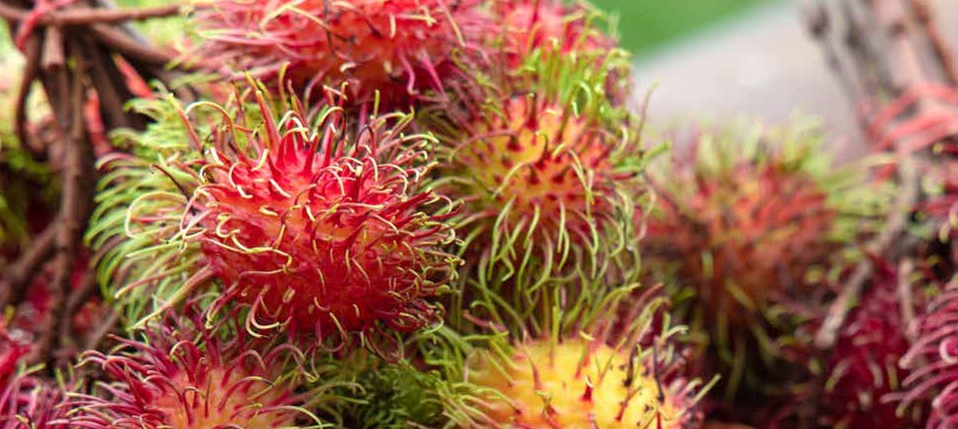
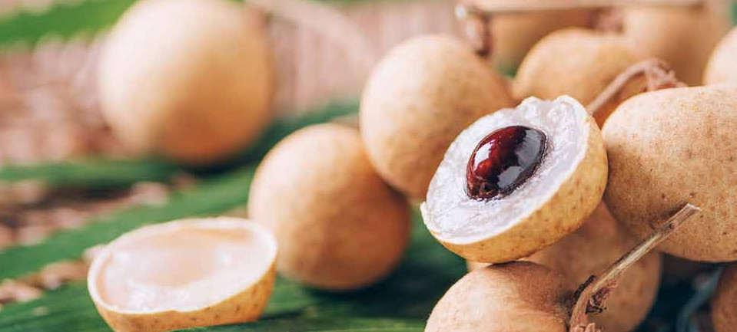
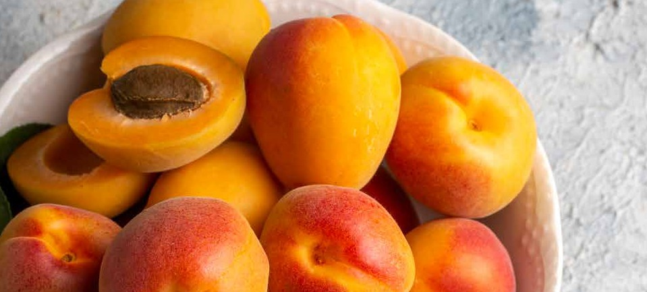
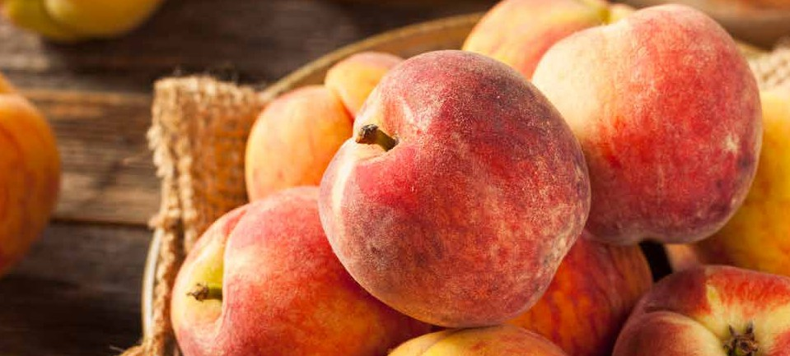
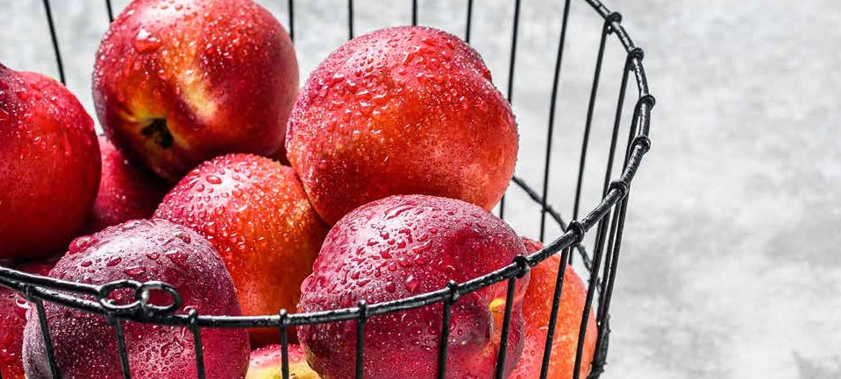
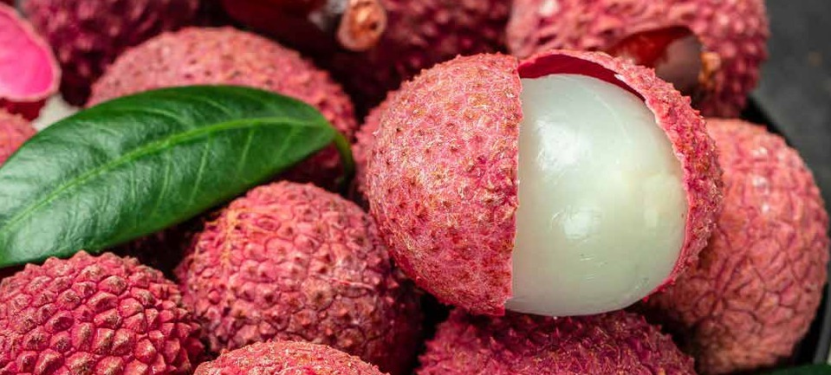
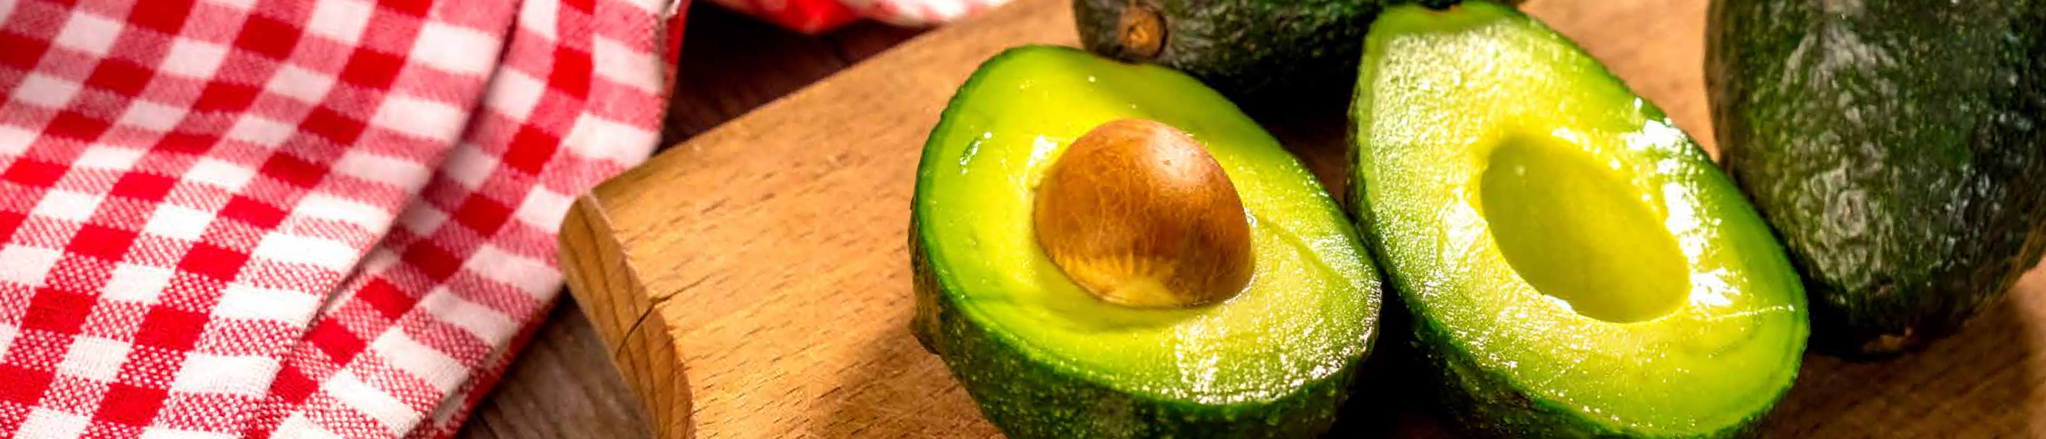
FRESH PRODUCE
AMENITY BASKET EXOTIC
RAMBUTTAN
LONGAN
ORIGIN
ORIGIN
Thailand/ Vietnam
Thailand/ Vietnam
APRICOT
ORIGIN
PEACHES
ORIGIN
South Africa/ Australia
South Africa/ Australia
NECTARINE
ORIGIN
LITCHI
ORIGIN
South Africa/ Australia
Thailand/ Vietnam
AVOCADO
VARIETY/CLASS
Normal/ Hass
ORIGIN
Kenya/ Tanzania/ Mexico

Slide 4
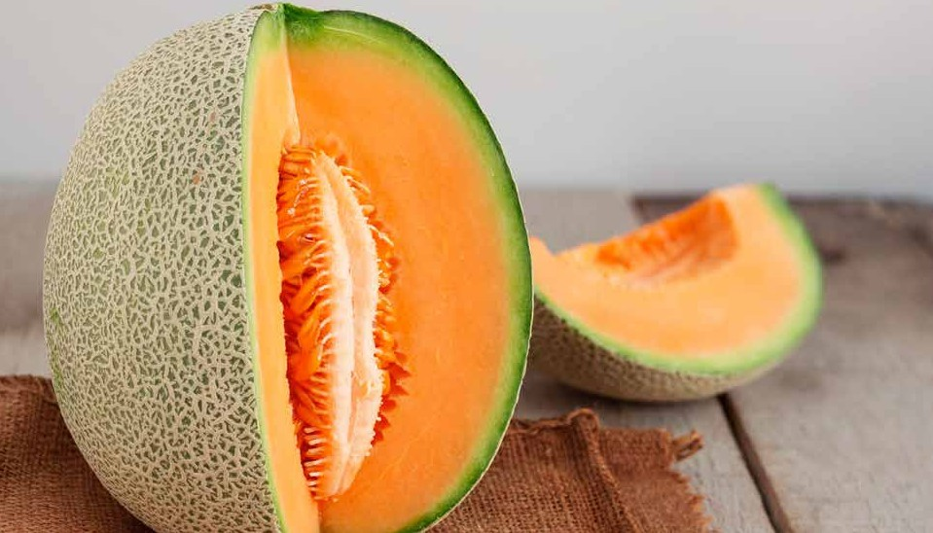
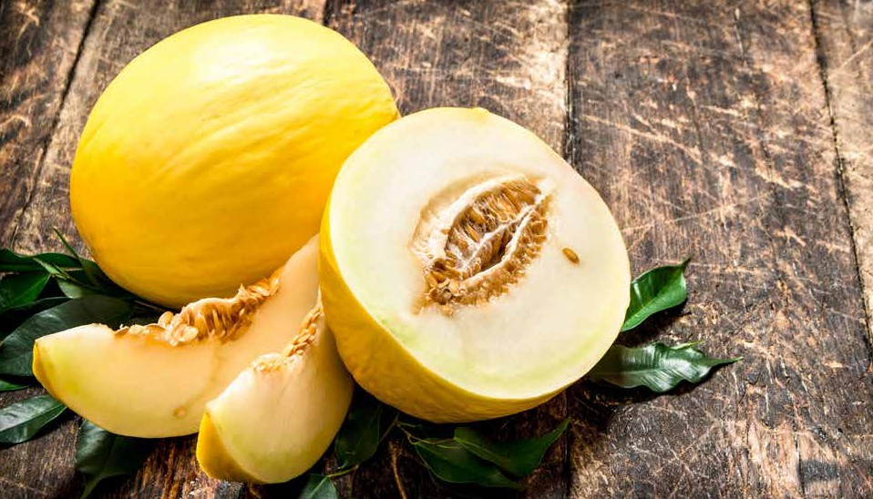
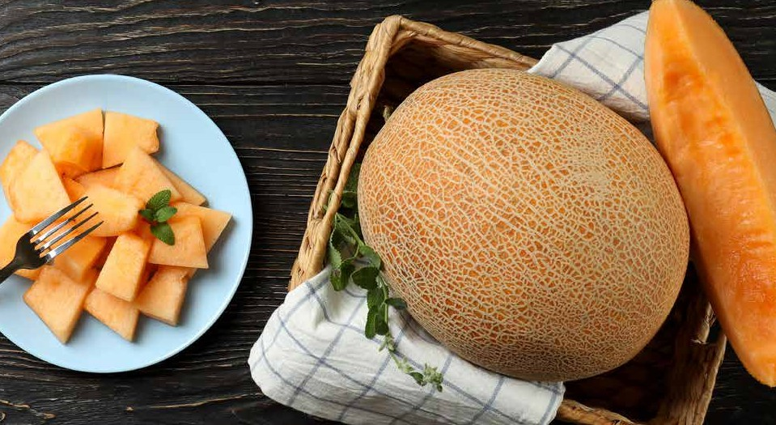

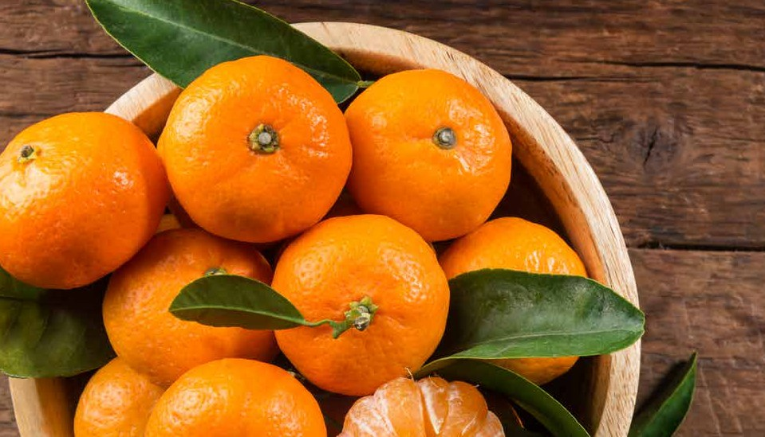
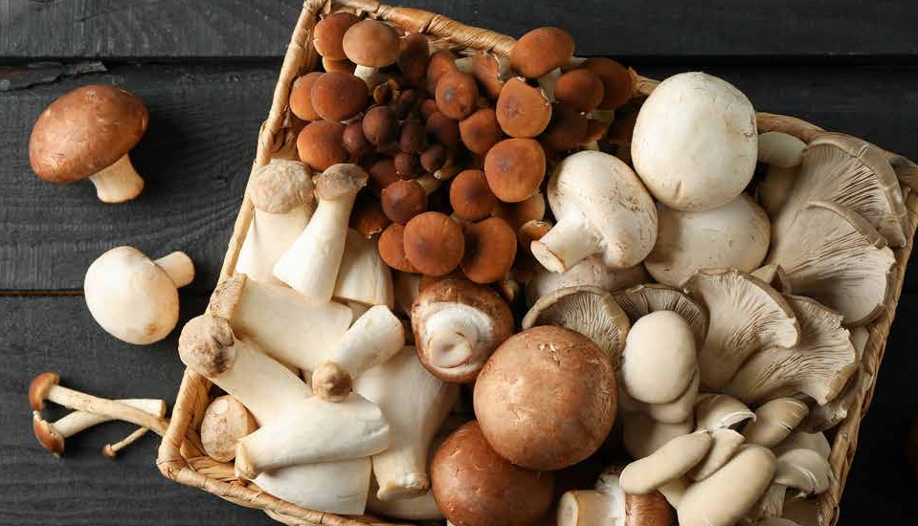
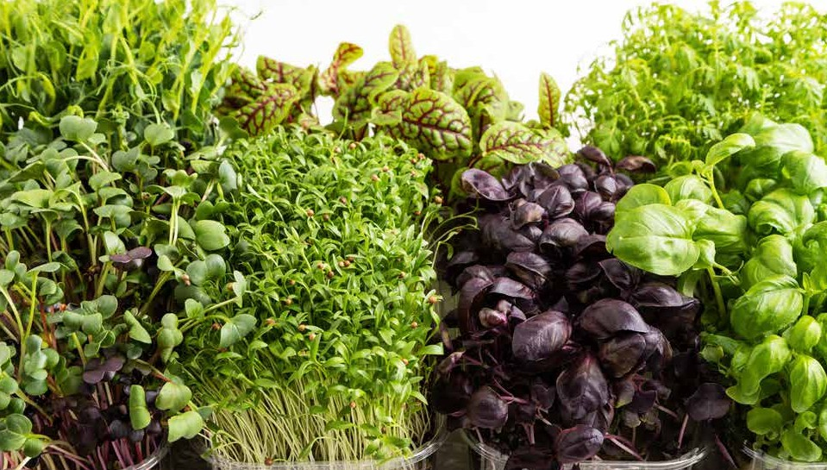
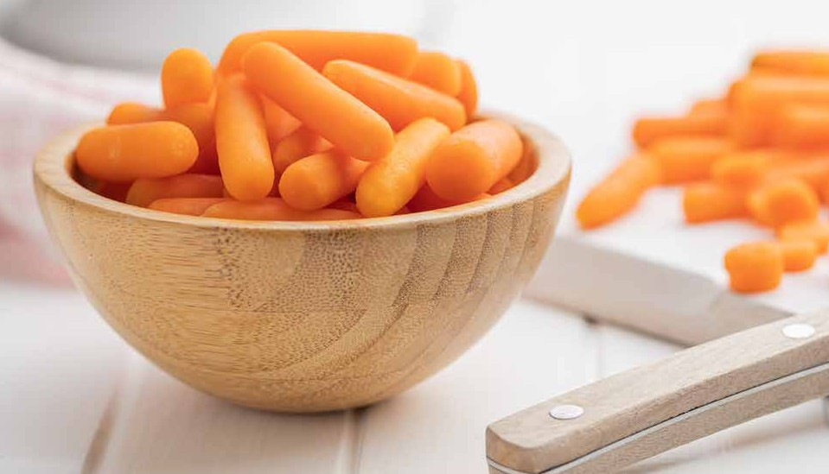
FRESH PRODUCE
ROCK MELON
HONEY DEW MELON
SWEET MELON
ORANGE
MANDARIN
MUSHROOMS
CRESSES
BABY CARROTS

Slide 5

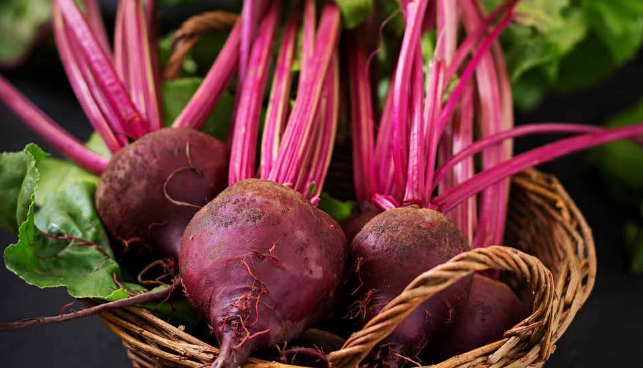
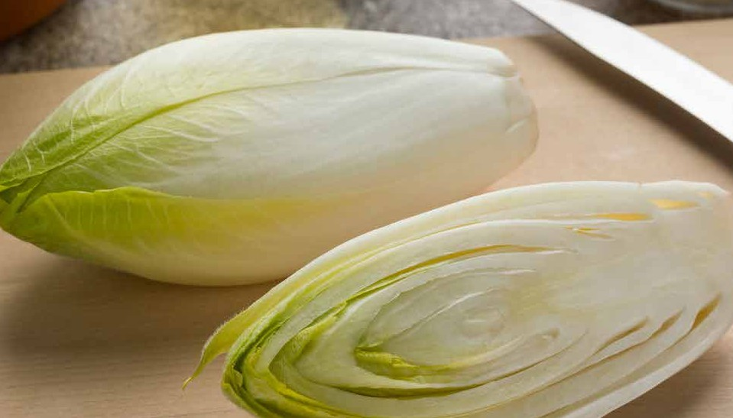
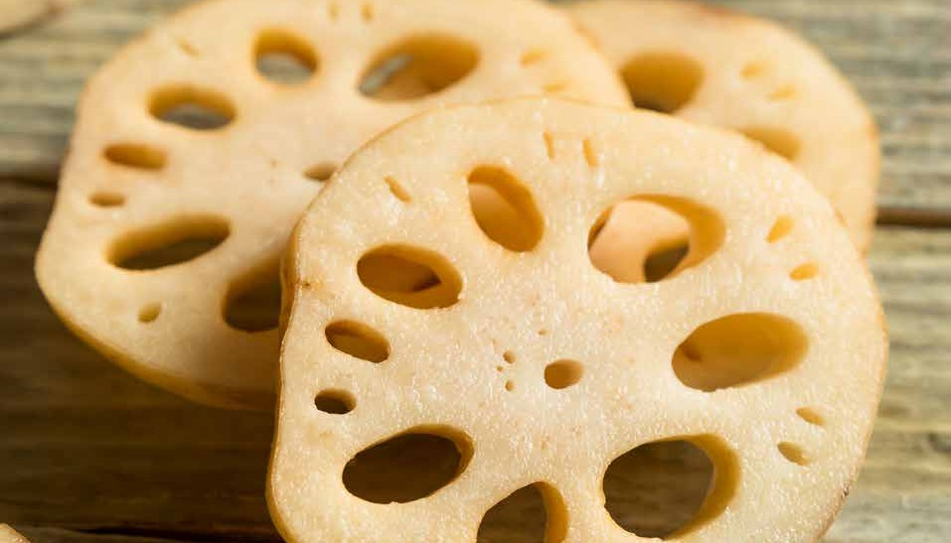
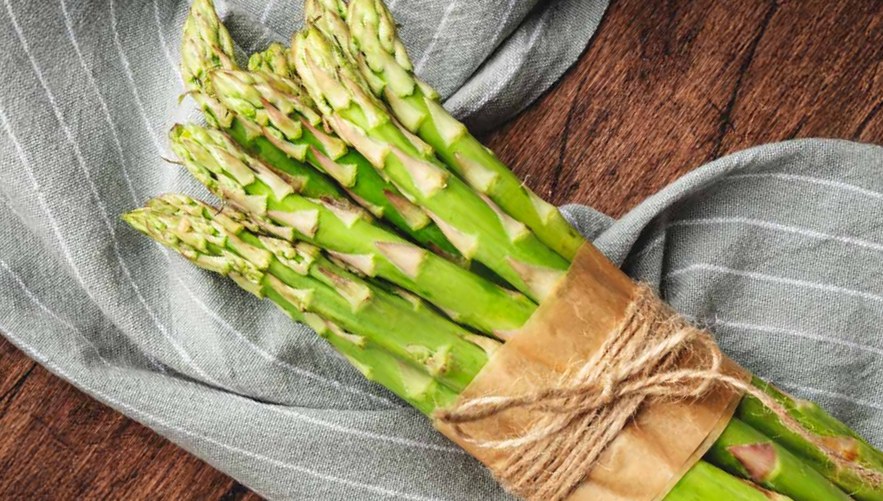
FRESH PRODUCE
CULINARY COLLECTION
EDIBLE FLOWERS
BABY BEETROOTS
CHICORY
LOTUS ROOT
ASPARAGUS

Slide 6
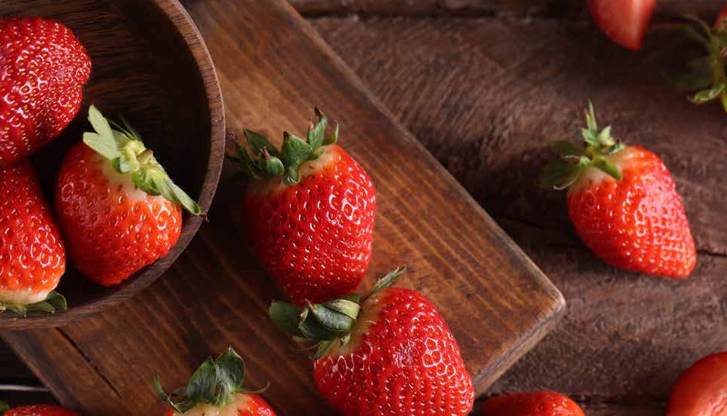

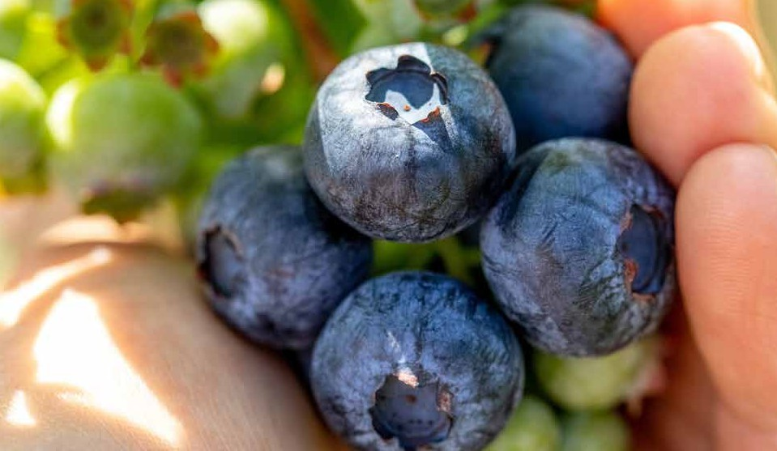

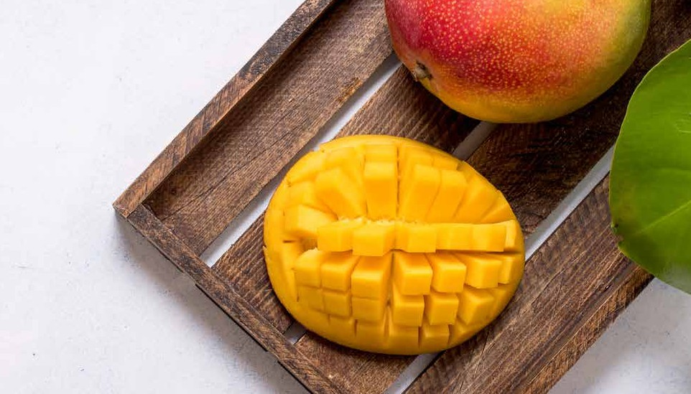
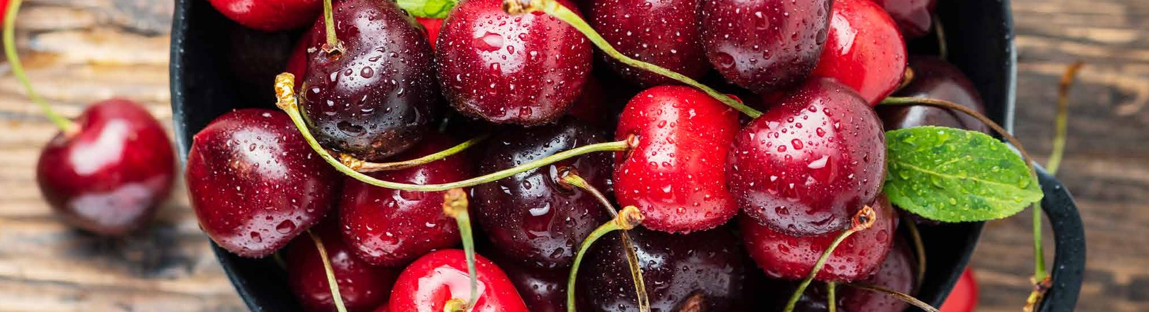
FRESH PRODUCE
DESSERT COLLECTION
STRAWBERRY
RASPBERRY
BLUEBERRY
BLACKBERRY
MANGO
MANGOSTEEN
CHERRY

Slide 7
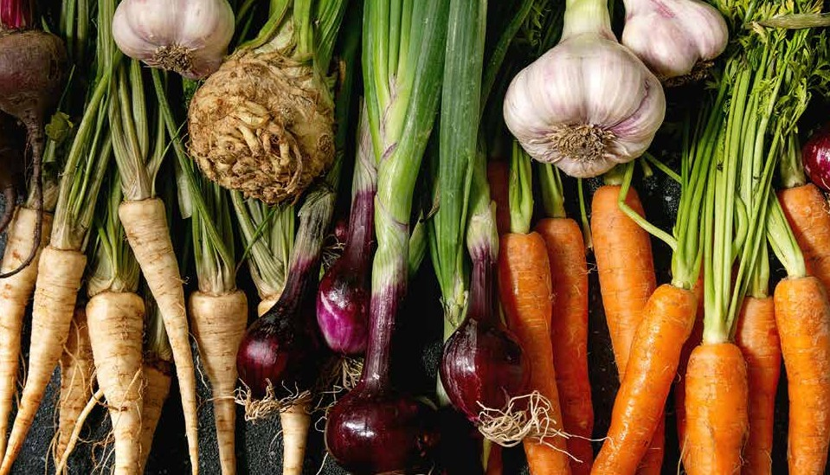
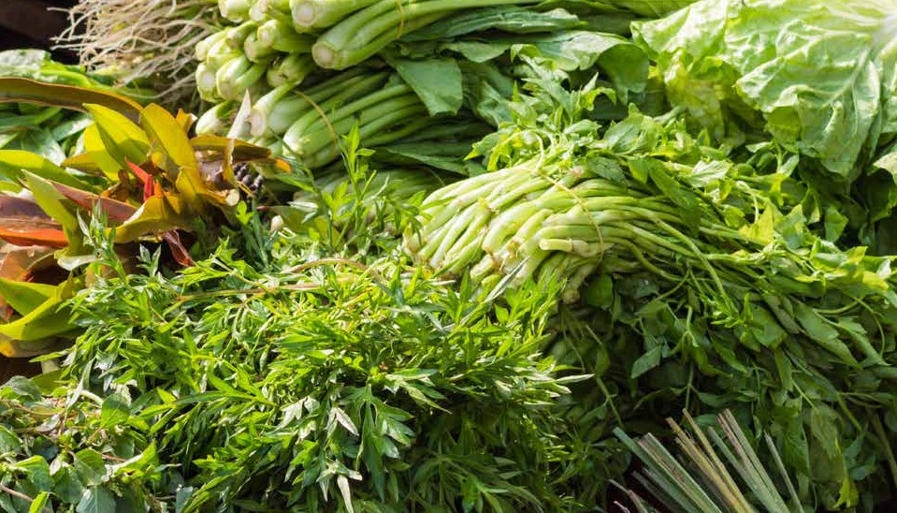
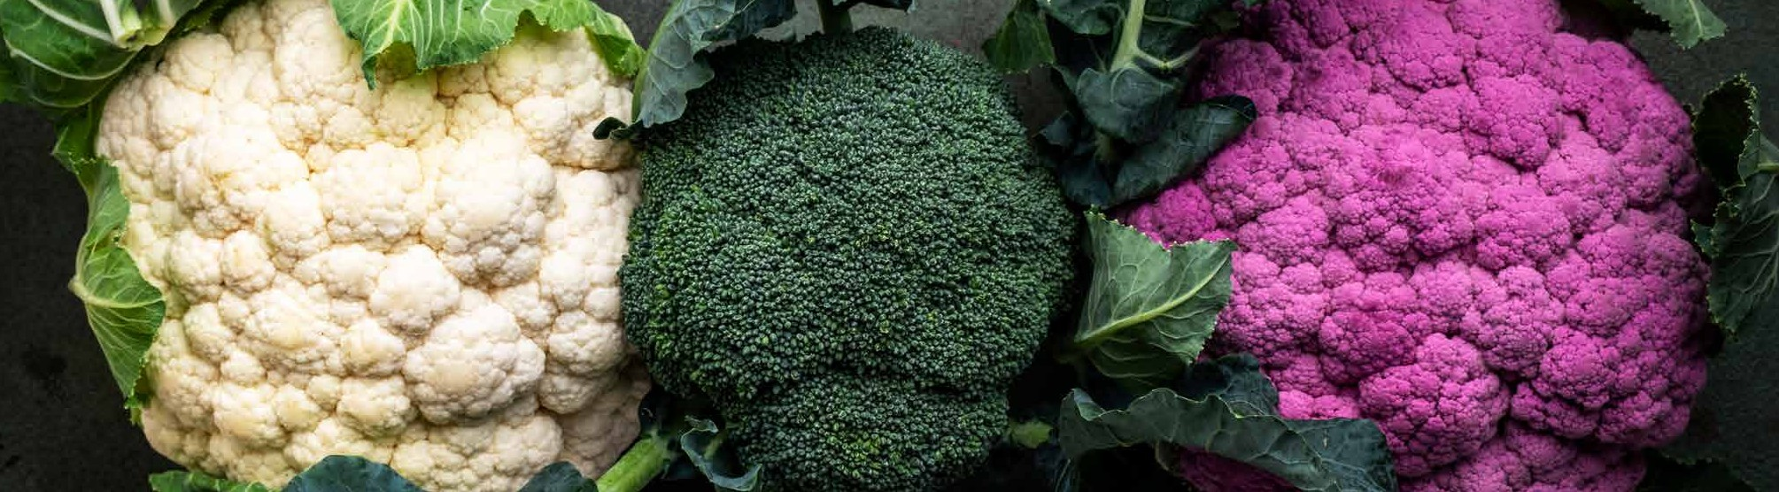
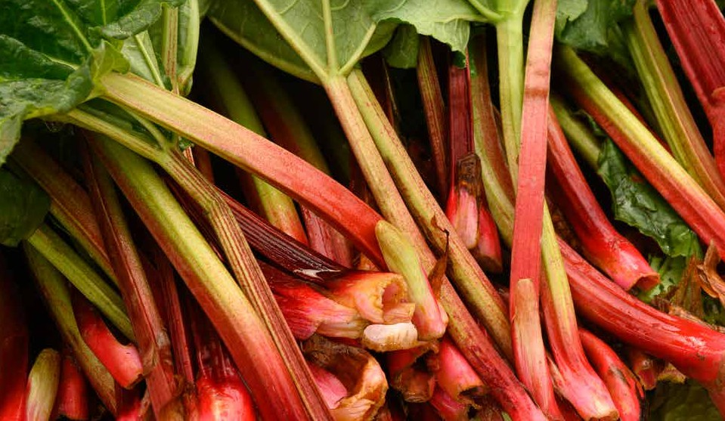
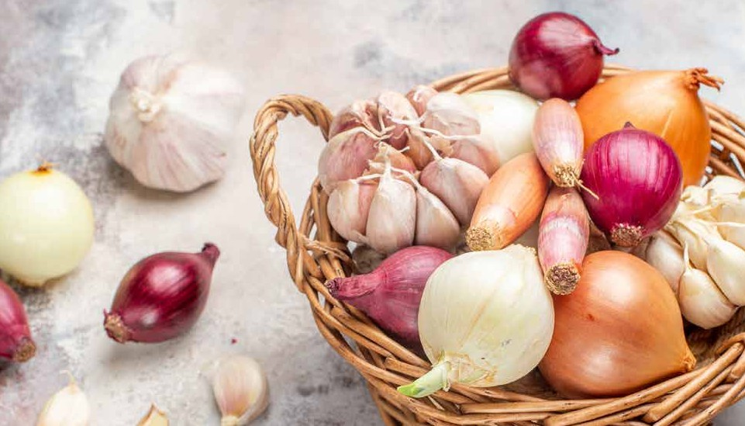
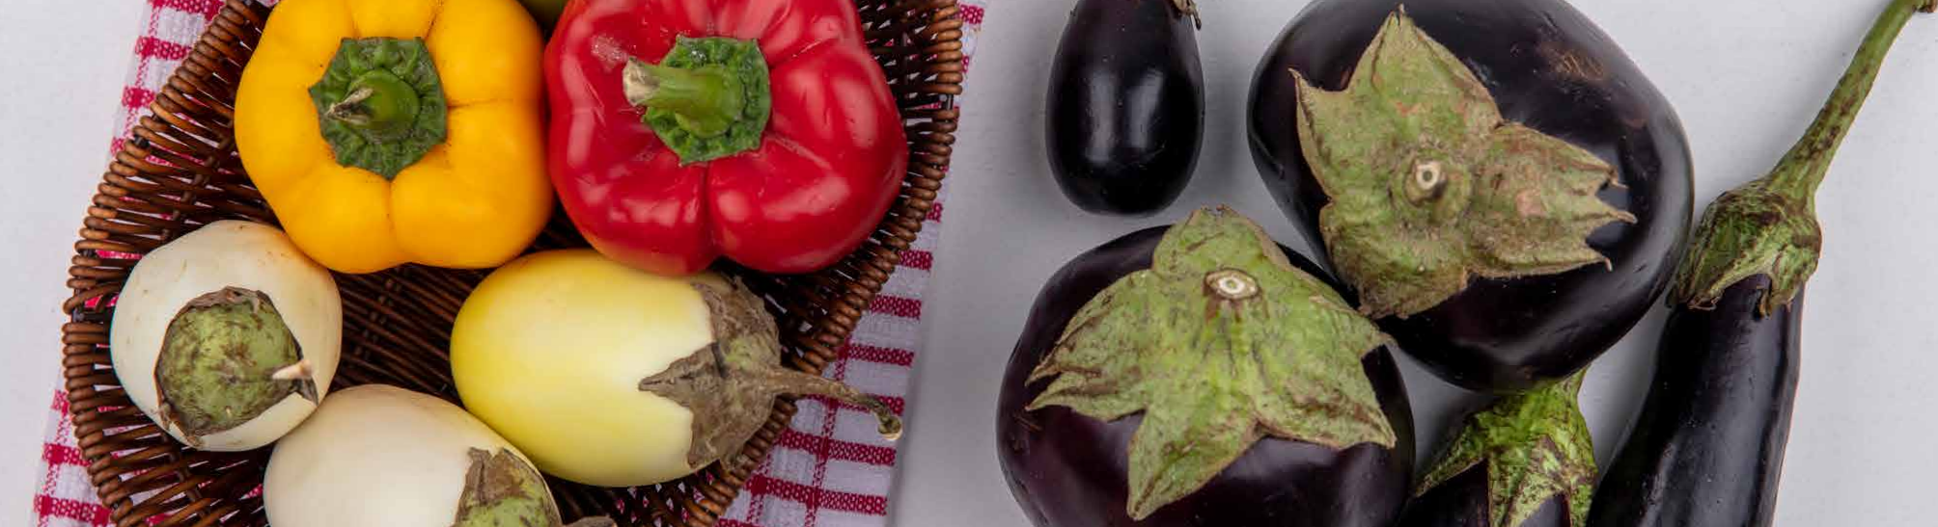
FRESH PRODUCE
ROOT VEG
LEAFY VEG
FLOWERS VEG
STEM VEG
BULB VEG
FRUITS VEG

Slide 8
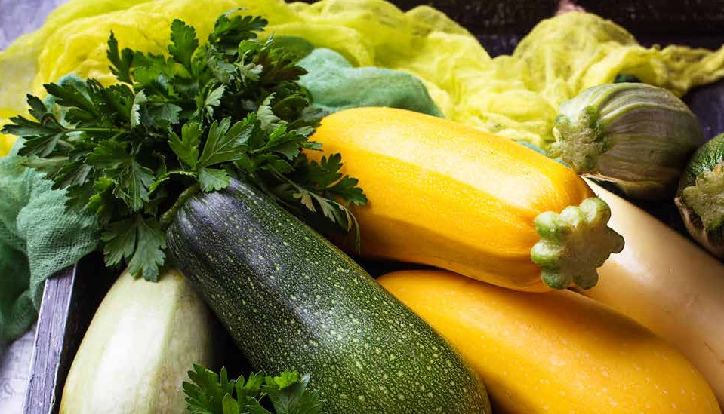
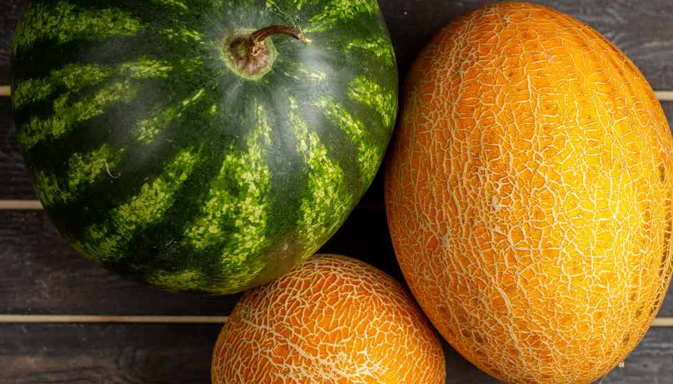
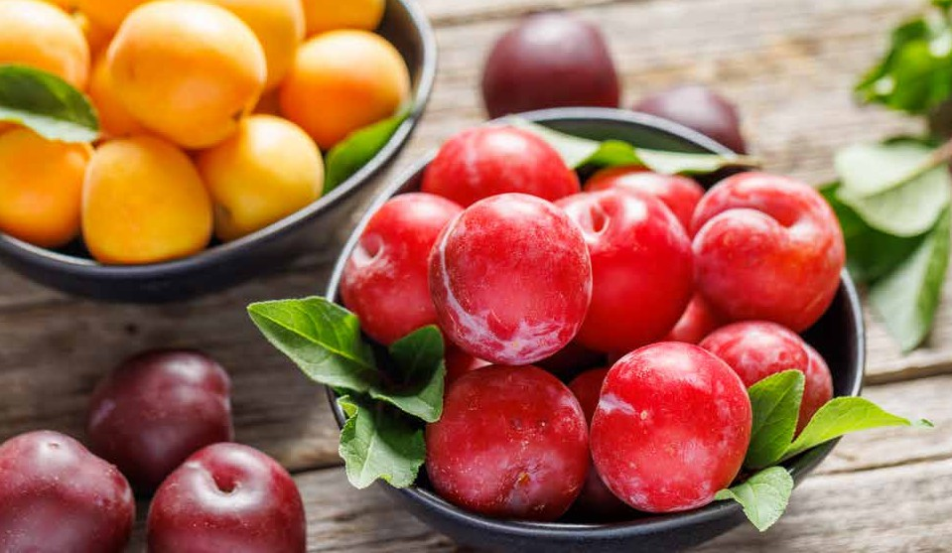
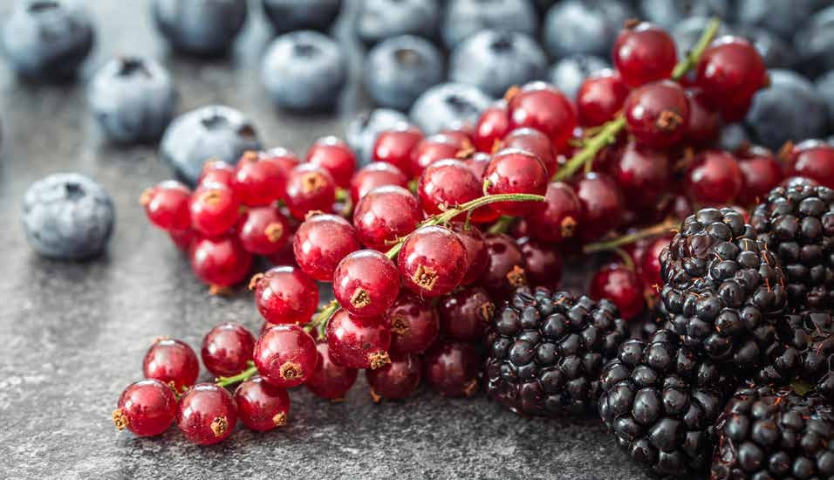
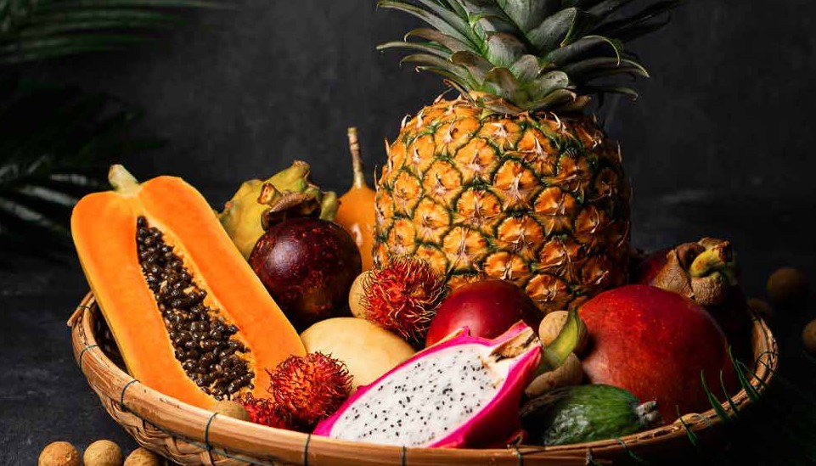
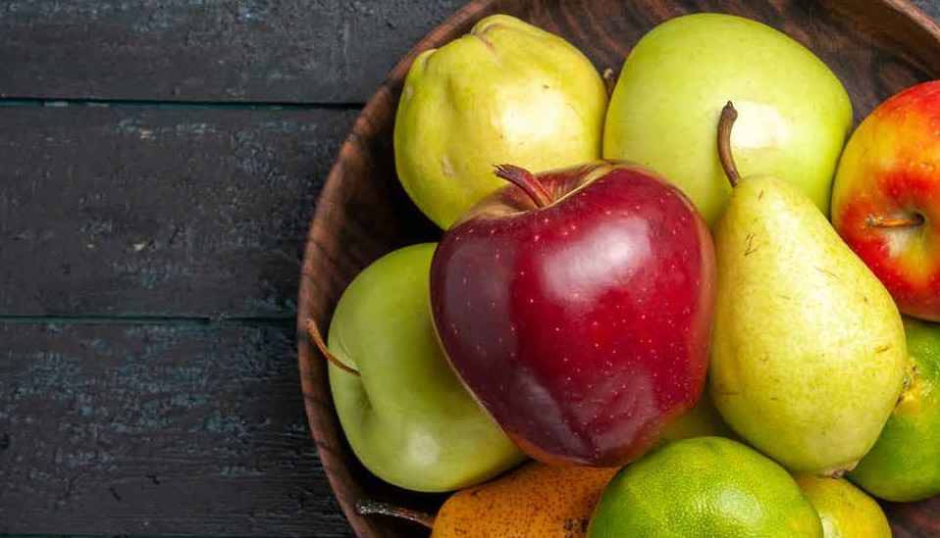

FRESH PRODUC
MARROW VEG
MELON FAMILY
STONE FRUITS
BERRIES
TROPICAL
POME FRUITS
CITRUS RANGE

Slide 9
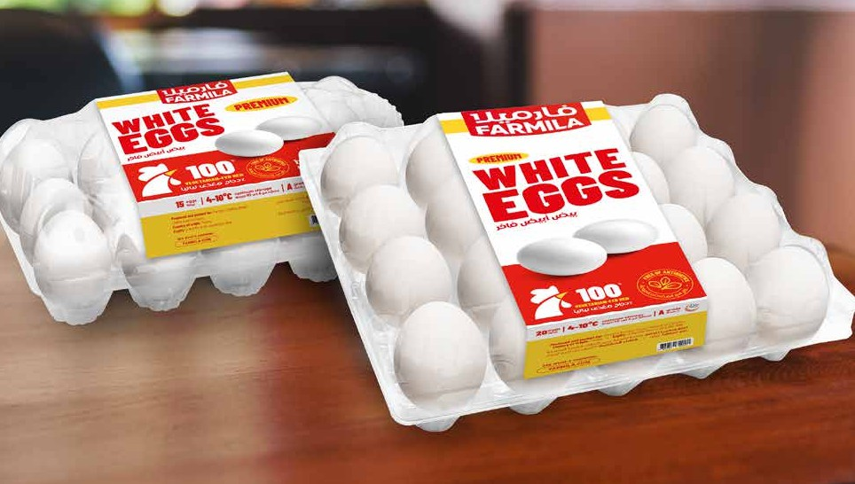
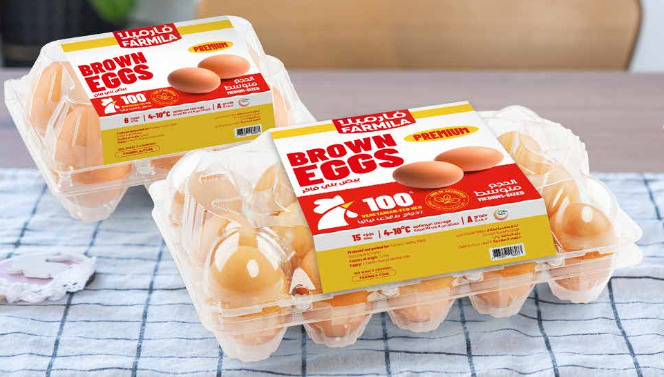
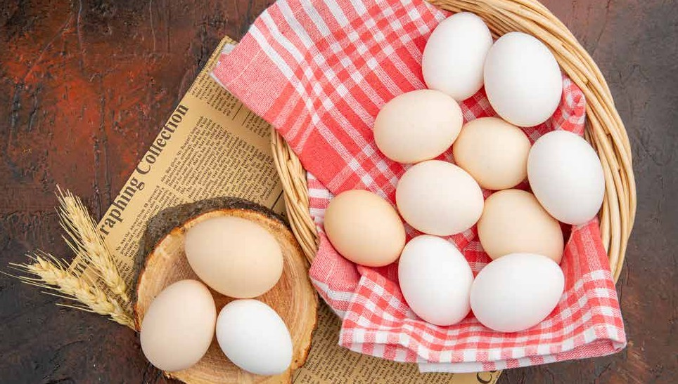
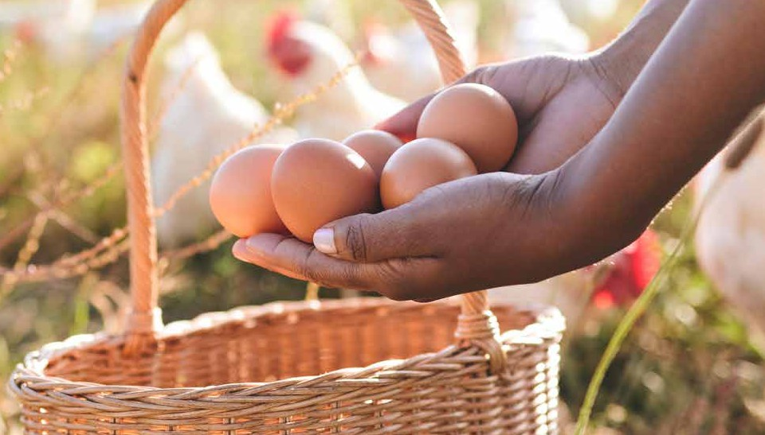
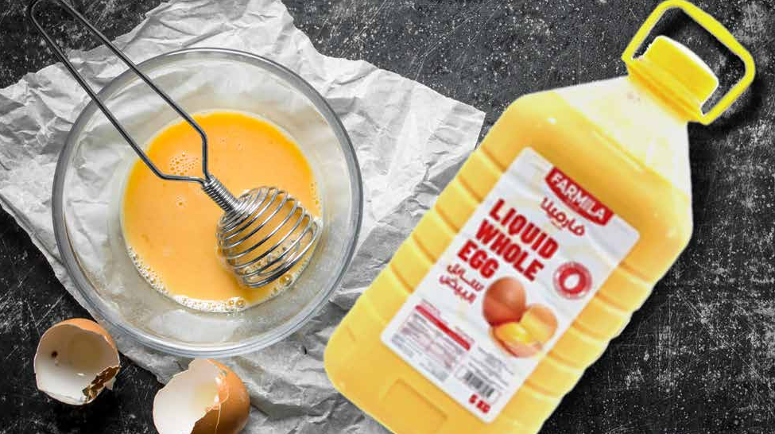
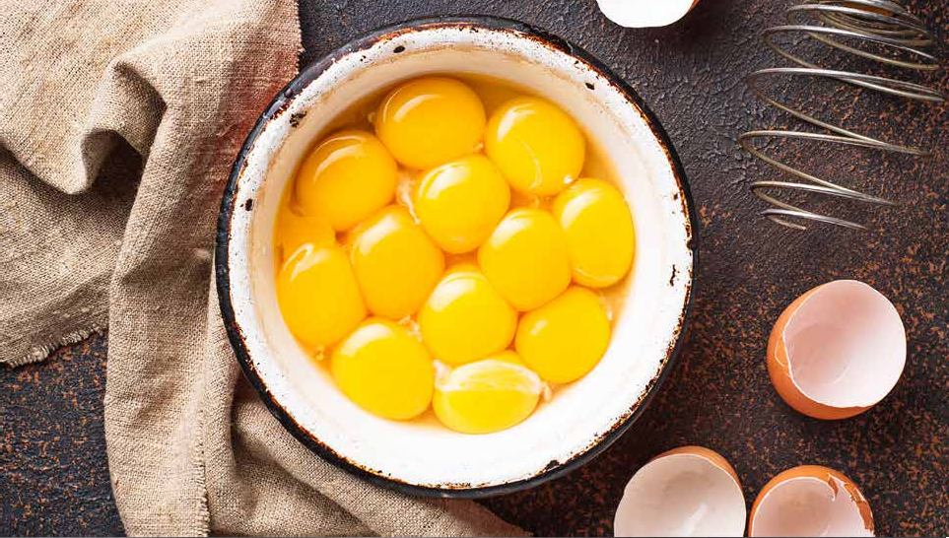
EGG
EGGS WHITE TRAY PACK
ORIGIN Turkey
PACKING Tray
SIZE Medium
EGGS BROWN TRAY PACK
ORIGIN Turkey/ Spain
PACKING Tray
SIZE Medium
FREE RANGE EGGS
ORIGIN UAE
PACKING Tray
SIZE Medium
ORGANIC EGGS
ORIGIN UAE
PACKING Tray
SIZE Medium
LIQUID EGG WHOLE
ORIGIN UAE
PACKING Pet Bottle
SIZE 1 Kg, 5 Kg
LIQUID EGG YOLK
ORIGIN UAE
PACKING Pet Bottle
SIZE 1 Kg

Slide 10

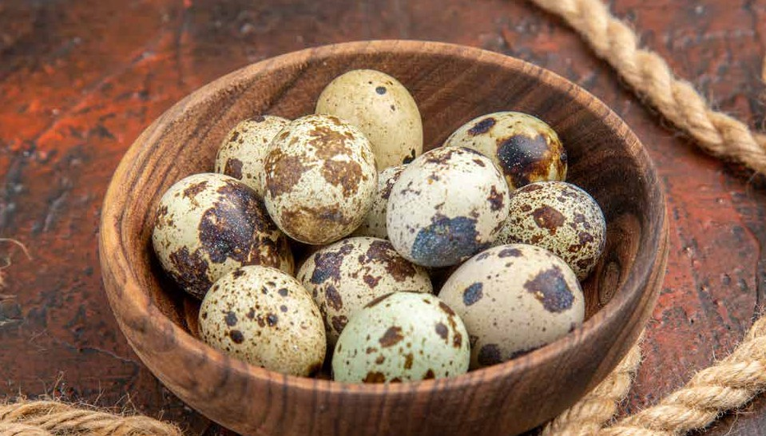
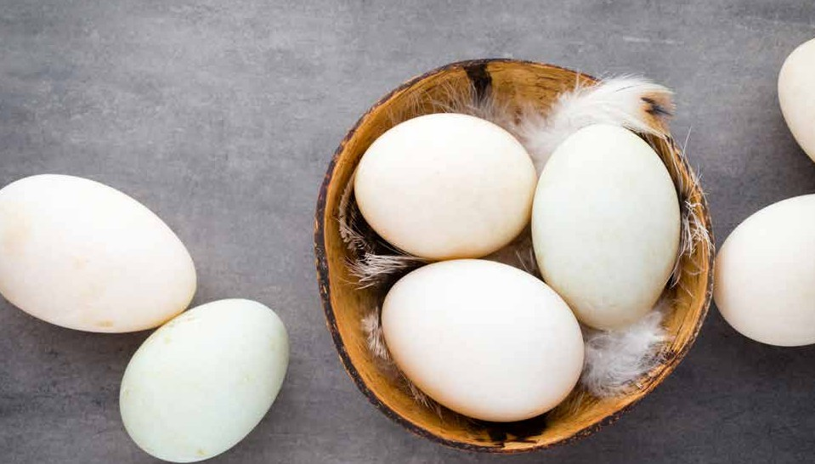

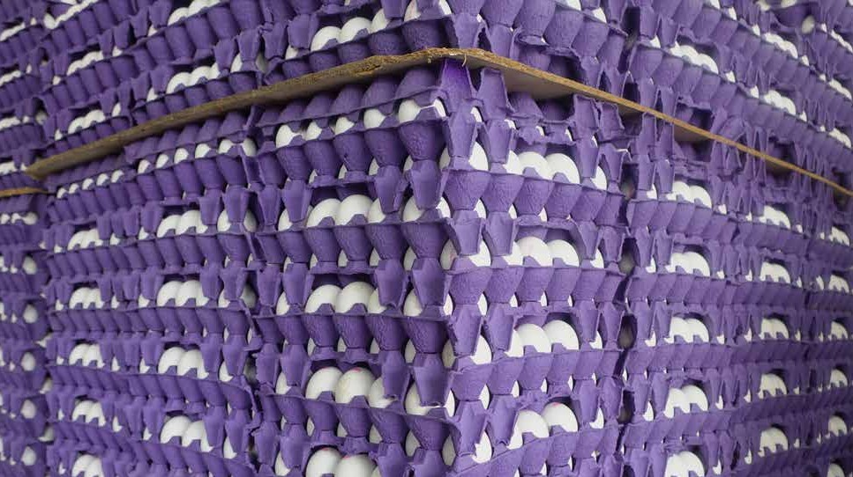

EGG
LQUID EGG IWHITE
ORIGIN UAE
PACKING Pet Bottle
SIZE 1 Kg
QUAIL EGGS TRAY PACK
ORIGIN Turkey
PACKING Tray
SIZE 12
QUAIL EGGS TRAY PACK
DUCK EGGS TRAY PACK
ORIGIN Thailand
PACKING Tray
SIZE 6
OSTRICH EGGS
ORIGIN UAE
PACKING pcs
SIZE 1
EGGS CARTON 360'S WHITE
ORIGIN UAE/ Turkey/ India
PACKING Carton
SIZE Medium/ Large
QUAIL EGGS CARTON 120'S
ORIGIN Turkey
PACKING Carton
SIZE Gures

